Slide 1

Sprint 1 Presentation
Golf Player Time Manager
Alyssa Beeker, Bailey Carlin, Daniel Teel, Elijah Hunt, Adam Horle

Slide 2
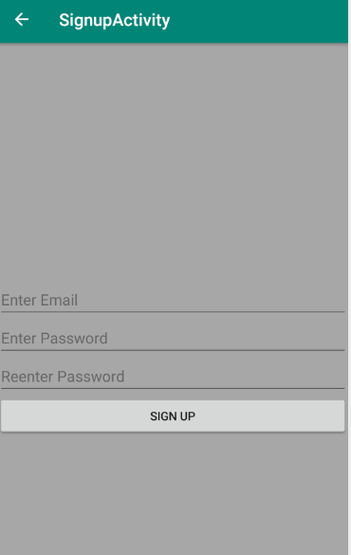
User Account Creation, Registration
Firebase makes it simple and easy
Checks if all fields are filled
Checks if user with that email already exists
Checks if both passwords match

Slide 3
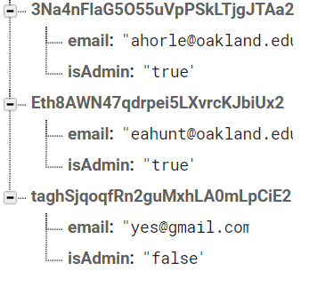
Role Management
Users automatically assigned to non admin
Administrators set through Firebase console

Slide 4
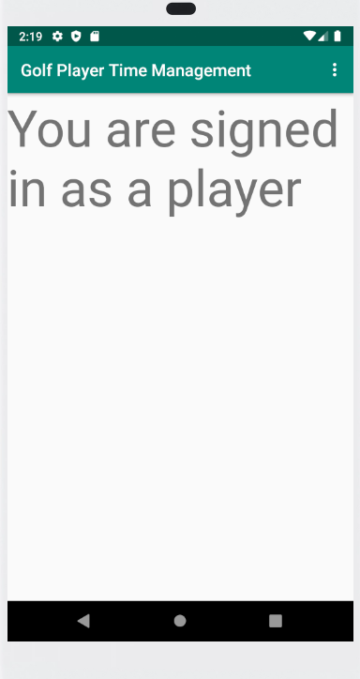
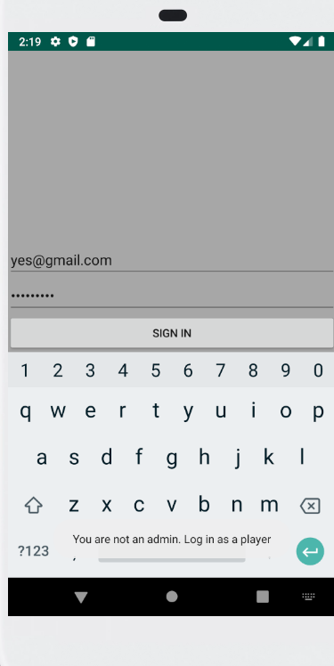
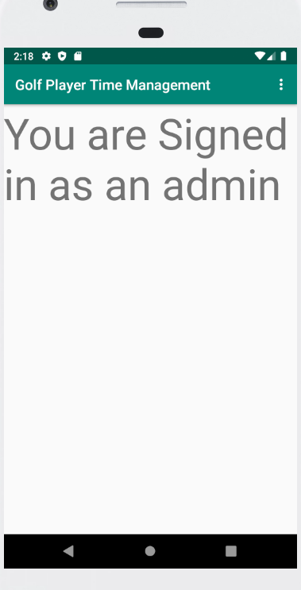
Profile Update
So far only distinction is between admins and non admins
Plan to show account info (email, possibly other attributes)

Slide 5
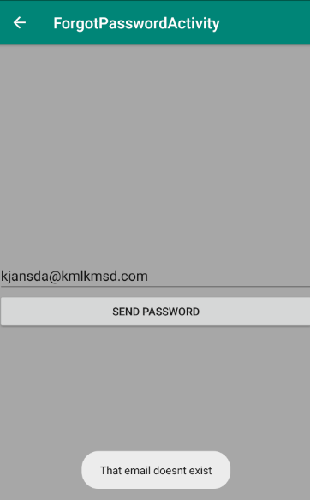
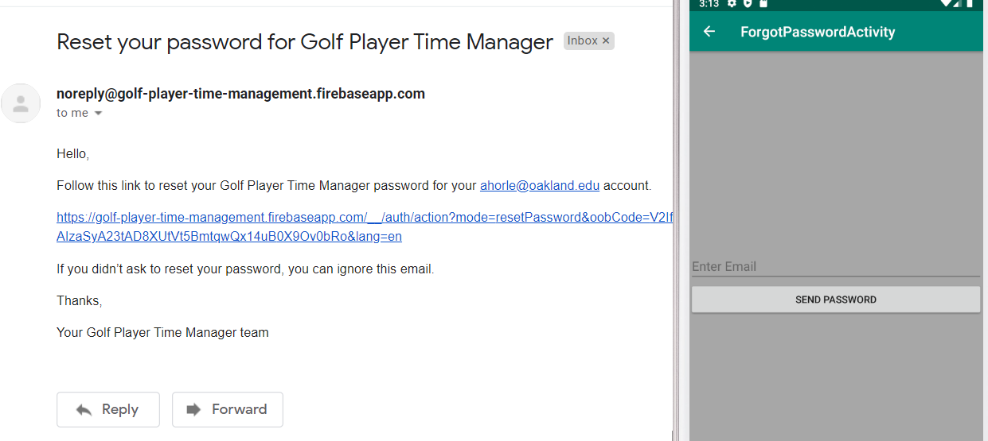
Forgot Password
Firebase makes it easy to send a reset password link through email

Slide 6
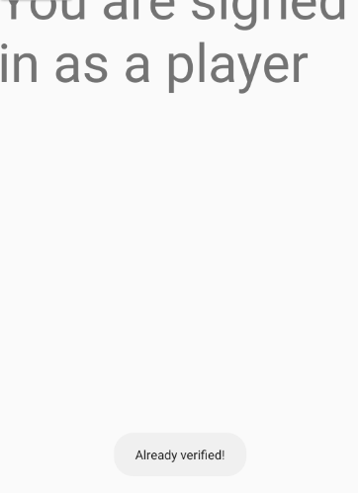
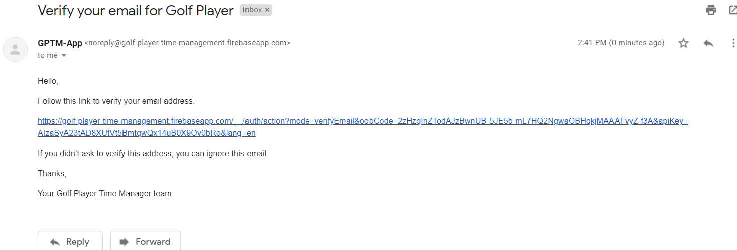
Email Verification
Would keep crashing if not assigned own button
Finally works

Slide 7
User Stories
“As a Golfer, I want to securely log in to the application so that my history, requests, and preferences are saved.”
“As a Golfer, I want to recover my password if I forgot it.”
“As a new user, I want to see if the email I want to sign-up with has already been used.”
“As an admin, I want to see who is and is not verified”

Slide 8
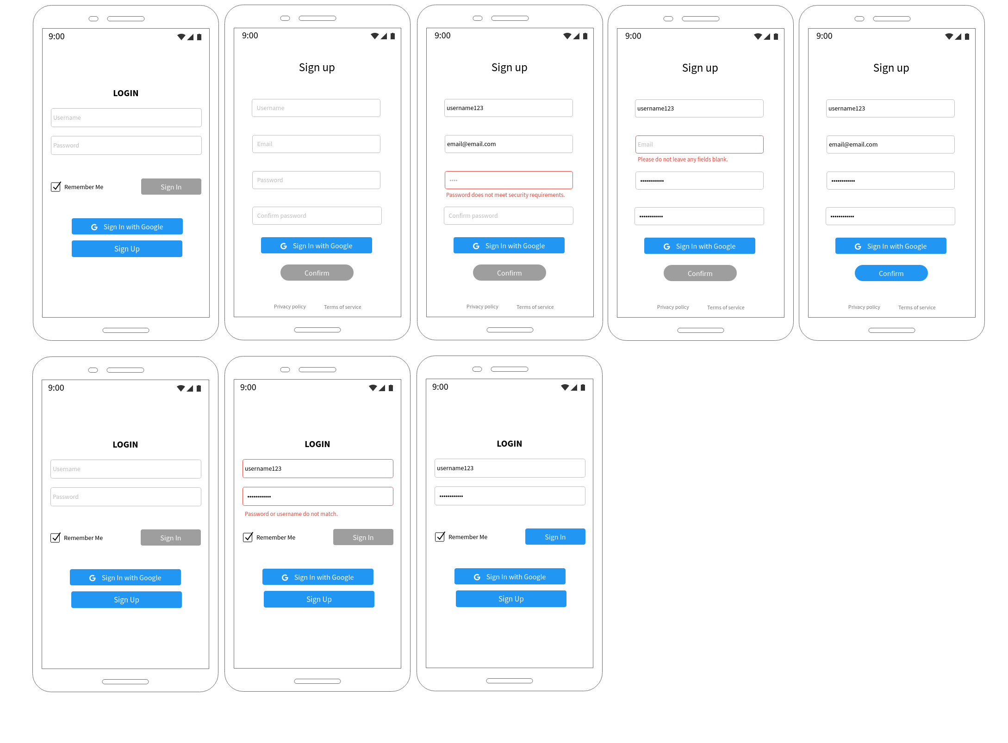
UI/UX

Slide 9
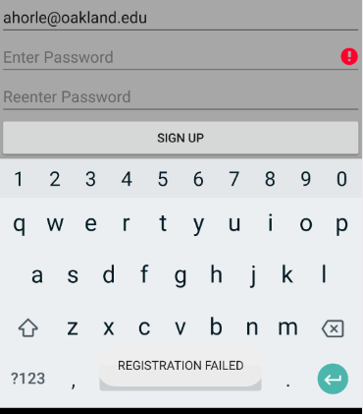
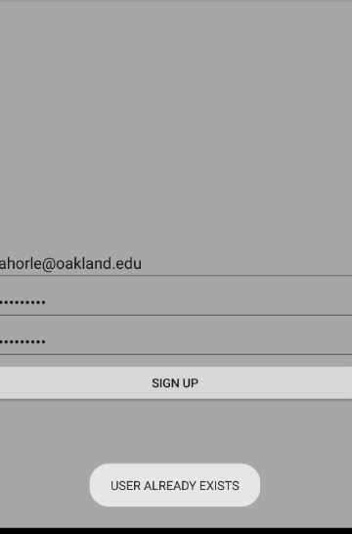
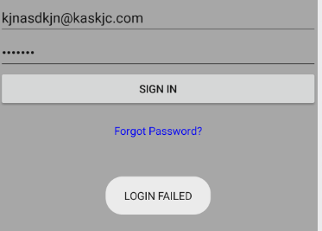
QA Tests
Basic allowance and disallowances checked

Slide 10

Challenges Encountered
Scheduling conflicts
Initial Git set up
When project was cloned there were some difficulties pointing it to the right SDK
Gradle Errors
Initialized project scrapped for Eli’s version
Unsure of formating for documentation
Needed to establish a template for future files

Slide 11

Sprint 2 Objectives
Golf course registration
Player
After signing in the user is taken to a list of golf courses
The user then selects the golf course and they will be taken to the player dashboard.
Admin
After signing in the user is taken to the list of golf courses
After selecting the golf course the user will be taken to the admin dashboard.
Begin research and set-up for Geofencing (officially starts in Sprint 3)

Slide 12
Questions??

